Slide 1

Chapter 9
Using Telephone
and Cable Networks
for Data Transmission
Copyright © The McGraw-Hill Companies, Inc. Permission required for reproduction or display.

Slide 2
9-1 TELEPHONE NETWORK
Telephone networks use circuit switching. The telephone network had its beginnings in the late 1800s. The entire network, which is referred to as the plain old telephone system (POTS), was originally an analog system using analog signals to transmit voice.
Topics discussed in this section:
Signaling
Services Provided by Telephone Networks

Slide 3
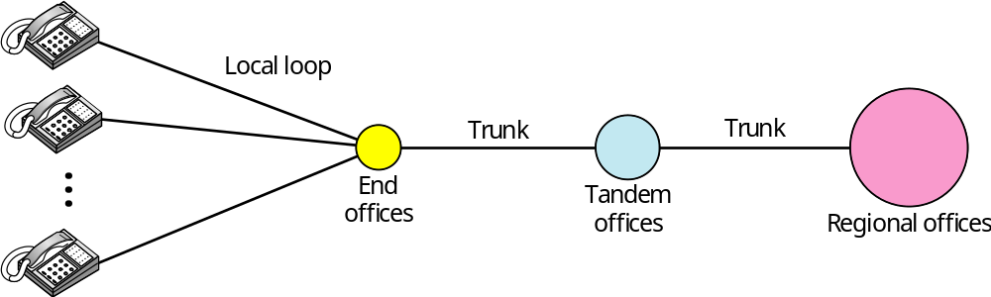
Figure 9.1 A telephone system

Slide 4
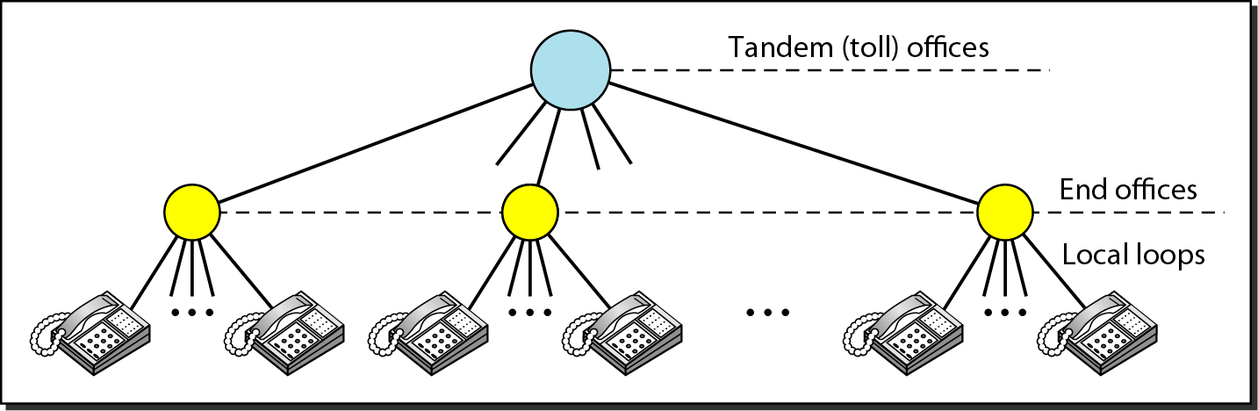
Figure 9.2 Switching offices in a LATA

Slide 5
9-2 DIAL-UP MODEMS
Traditional telephone lines can carry frequencies between 300 and 3300 Hz, giving them a bandwidth of 3000 Hz. All this range is used for transmitting voice, where a great deal of interference and distortion can be accepted without loss of intelligibility.
Topics discussed in this section:
Modem Standards

Slide 6
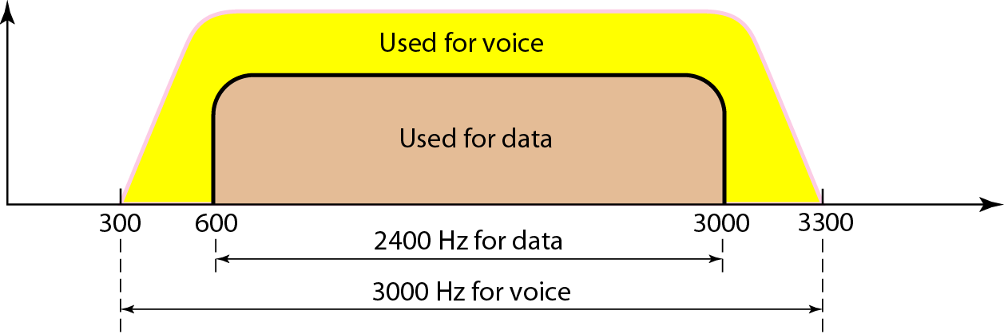
Figure 9.6 Telephone line bandwidth

Slide 7

Note
Modem
stands for modulator/demodulator.

Slide 8
Digital Signals
The signals used on the local loop are baseband, limited by filters to the frequency range 300 Hz to 3.3 KHz.
If a digital signal were to be applied to one end of the line, the received signal at the other end would not show a square waveform, due to capacitance and inductance effects of the line.
The full bandwidth of 3 KHz is used for transmitting voice.
Data transmission requires a higher degree of accuracy (less distortion) and therefore the effective bandwidth used is 2.4 KHz.

Slide 9
Analog Signals
In essence, Baseband signaling is inherently inefficient because it requires a wide range of harmonics and is prone to delay distortion.
To get around these problems, Broadband signaling is used whereby a single, continuous frequency is modulated by the input signal.
A continuous tone in the 1 KHz to 2 KHz range is introduced, called a sine wave carrier. Its amplitude, frequency, or phase can be modulated to transmit information.
This technique allows us to transmit digital data over the public telephone network.
A Modem (Modulator-Demodulator) is used to convert digital data to analog signals through the process of modulation.

Slide 10
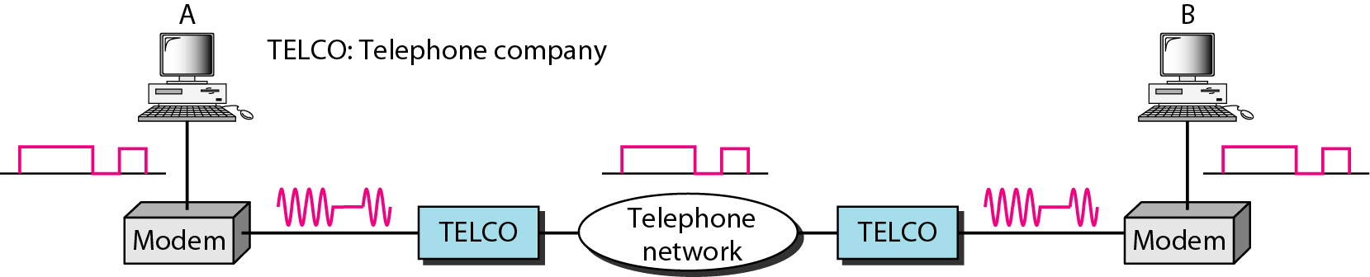
Figure 9.7 Modulation/demodulation

Slide 11
Current Modem Standards
V.32 bis
14,000 bps (6 bits/baud, 64 point constellation)
64-QAM at a rate of 2400 baud.
V.32terbo
Enhanced version of V.32 bis.
Uses 256-QAM to achieve a bit rate of 19,200 bps.

Slide 12
Newer standards
V.34 (V.Fast)
28,800 bps (6 bits/baud + 1 parity bit, 128 point constellation)
Uses Trellis coding and data compression for higher bit rates.
V.42 bis
Uses Ziv-Lempel compression algorithm to achieve compression of up to 4:1.
For example, a 9600 bps V.32 modem can achieve 38,400 bps.
The data compression allows the system to send more bits in a predefined period.

Slide 13
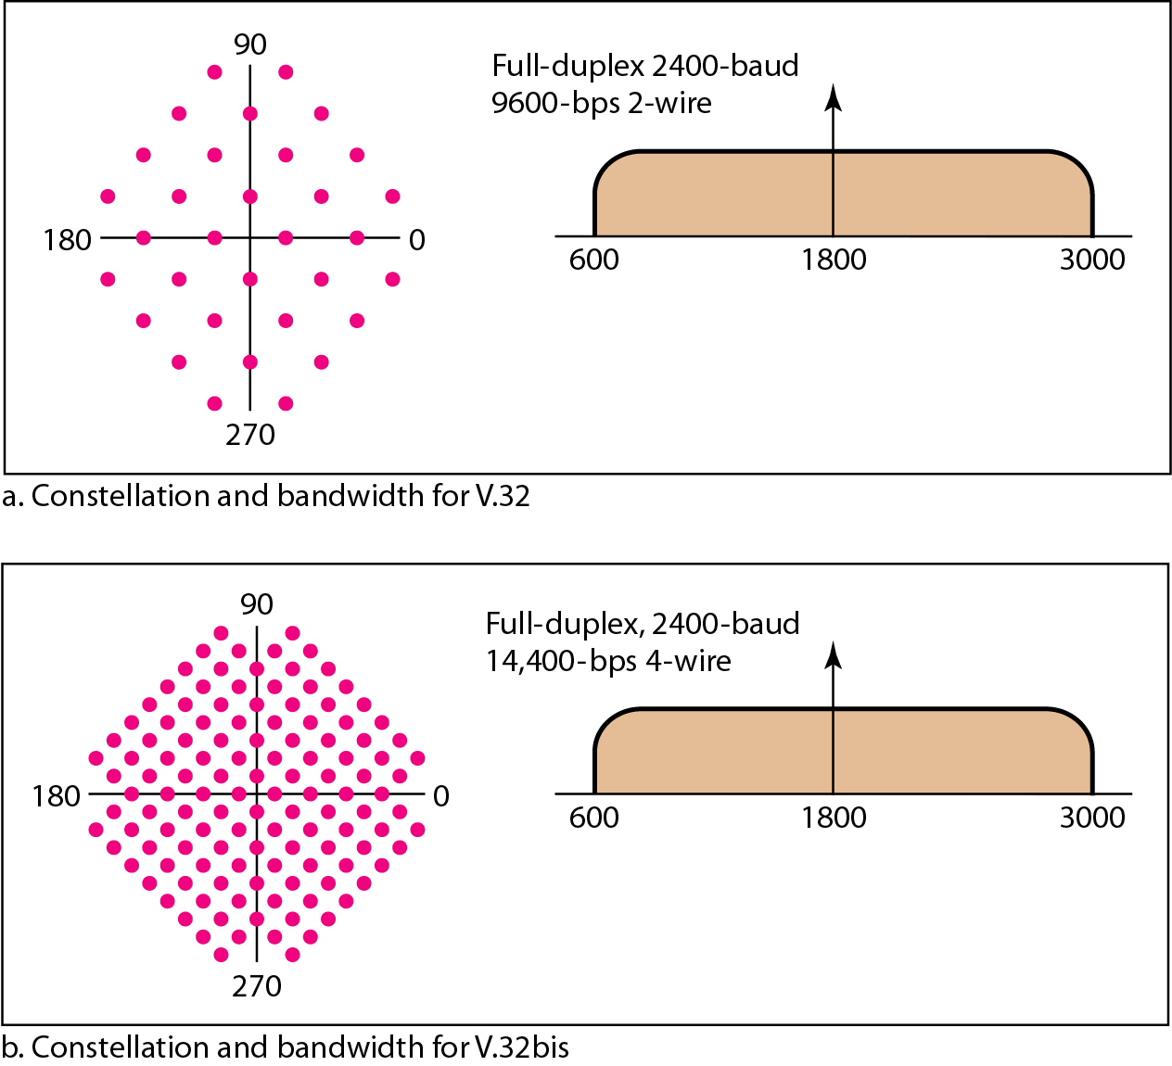
Figure 9.8 The V.32 and V.32bis constellation and bandwidth

Slide 14
56Kbps Modems
Traditional modems are limited to a maximum of 33.6 Kbps given the noise and bandwidth constraints.
Newer 56K modems achieve higher (asymmetrical) data rates using digital signaling at the provider end.
The data rate is asymmetrical in that the users can download at a maximum of 56 kbps and upload at a maximum rate of 33.6 Kbps.
In a link using traditional modems the analog signal is converted to digital data using PCM and one end and then converted back to analog using inverse PCM at the receiver end.

Slide 15
Download speeds of 56kpbs
The PCM conversion process is the limiting factor in this system. Specifically the quantization noise limits the data rate to 33.6 Kbps.
In a system using 56 Kbps modems, the PCM process is eliminated at the Internet provider end. Since there is no quantization noise the download bit rate from the provider to user is 56 Kbps.
The path from user to provider (upload) still uses PCM to quantized the local loop signals and therefore is limited to 33.6 Kbps.

Slide 16
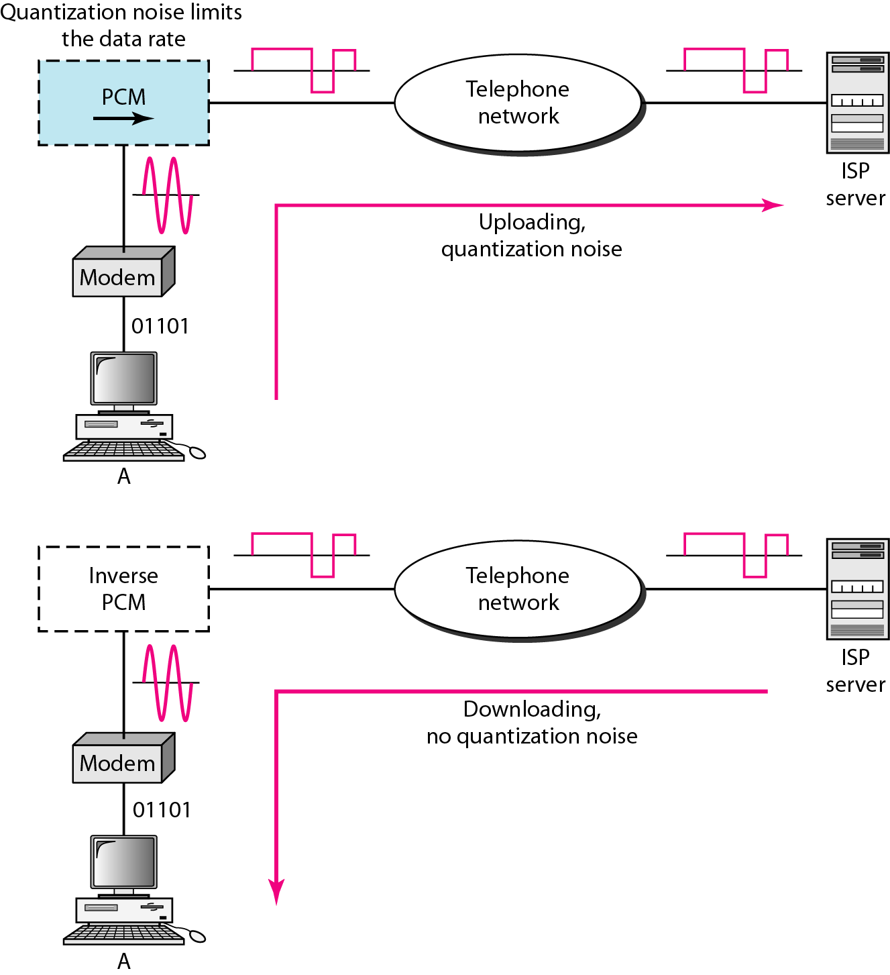
Figure 9.9 Uploading and downloading in 56K modems

Slide 17
9-3 DIGITAL SUBSCRIBER LINE
After traditional modems reached their peak data rate, telephone companies developed another technology, DSL, to provide higher-speed access to the Internet. Digital subscriber line (DSL) technology is one of the most promising for supporting high-speed digital communication over the existing local loops.
Topics discussed in this section:
ADSL
ADSL Lite
HDSL
SDSL
VDSL

Slide 18
ADSL
ADSL is a local loop transmission technology that simultaneously transports the following via one pair of wires:
Downstream (towards customer) bit rates of up to 8 Mbps.
Upstream (towards network) bit rates of 1 Mbps.
Plain old Telephone Service (POTS, i.e., analog voice)
The downstream bit rate is much greater than the upstream, hence the term asymmetric.
Analog voice is transmitted at baseband frequencies and combined with the passband data transmission via a low-pass filter (LPF) that is commonly called a “splitter”.
.

Slide 19
Basic Modulation
ADSL systems use a Frequency Division Multiplexed (FDM) transmission technique, which places upstream transmission at a frequency band separate from the downstream band to prevent self-crosstalk.
ADSL can be seen as a FDM system in which the available bandwidth of a single copper-loop is divided into three parts as shown. Guard bands are necessary to prevent POTS noise from interfering with the digital transmission.
The first band, normally between 0 and 25 KHz, is used for POTS. This service uses only 4 KHz of this band; the rest is used as the guard band to separate the voice channel from the data channels.
The second band, usually between 25 and 200 KHz, is used for upstream communication. The third band, usually 250 KHz to I MHz, is used for downstream communication

Slide 20
Modulation Techniques
Original implementations used a modulation technique called carrier-less amplitude/phase (CAP).
The current technique is called Discrete Multitone Technique (DMT) and is standardized by ANSI.
The basic idea of DMT is to split the available bandwidth into a large number of subchannels. Data is allocated so that the throughput of every single subchannel is maximized.
If a subchannel cannot carry any data, it can be turned off and the use of available bandwidth is optimized.
DMT combines QAM and FDM. The available bandwidth for each direction is divided into 4-KHz channels, each having its own carrier frequency.

Slide 21
DMT
For a system with N channels, the bits created by the source are passed through a serial-to-parallel converter, where a block of N bits is divided into N parallel paths, each consisting of one bit.
The QAM signals created from each path are frequency multiplexed together and the result is sent to the line.
The ANSI standard defines a rate of 60 Kbps for each 4-KHz channel, which requires QAM with 15 bits per baud.
The upstream channel usually occupies 25 channels, which provides a bit rate of 1.5 Mbps (25*60 Kbps). Noise restricts this data rate to 1 Mbps.
The downstream channel usually occupies 200 channels, which provides a bit rate of 12 Mbps (200*60 Kbps). Noise restricts this within a range of 500 Kbps to 8 Mbps.

Slide 22
Rate Adaptive Asymmetrical Digital Subscriber Line (RADSL)
This DLS technology allows different data rates depending on the type of communication required by the customer.
Different signal sources such as voice, audio, video and graphics will be assigned varying data rates based their bandwidth demands.
The main advantage here is that the cost is based on the data rate required and assigned.

Slide 23
High Bit Rate Digital Subscriber Line (HDSL)
This scheme was designed an alternative to the T- I line (1.544 Mbps). The T-1 line uses AMI encoding, which is very susceptible to attenuation at high frequencies. This limits the length of a T-1 line to 1 Km. For longer distances, a repeater is necessary, which results in increased costs.
AMI (Alternate Mark Inversion) is a synchronous clock encoding technique that uses bipolar pulses to represent logical 1 values. It is therefore a three level system.
A logical 0 is represented by no symbol, and a logical 1 by pulses of alternating polarity.
A data rate of almost 2 Mbps can be achieved without repeaters up to a distance of 3.6 Km. HDSL uses two twisted-pair wires to achieve full-duplex transmission

Slide 24
Symmetric DSL (SDSL)
Same as HDSL but uses one single twisted-pair cable, available to most residential subscribers, to achieve the same data rate as HDSL.
A technique called echo cancellation is employed to create a full-duplex transmission.

Slide 25
Very High Bit Rate DSL (VDSL)
Similar to ADSL but uses coaxial, fiber-optic, or twisted-pair cable for short distances (300 to 1800 meter s).
The modulating technique is DMT with a bit rate of 50 to 55 Mbps downstream and 1.5 to 2.5 Mbps upstream.

Slide 26
Note
ADSL is an asymmetric communication technology designed for residential users; it is not suitable for businesses.

Slide 27
Note
The existing local loops can handle bandwidths up to 1.1 MHz.

Slide 28
Note
ADSL is an adaptive technology.
The system uses a data rate
based on the condition of
the local loop line.

Slide 29
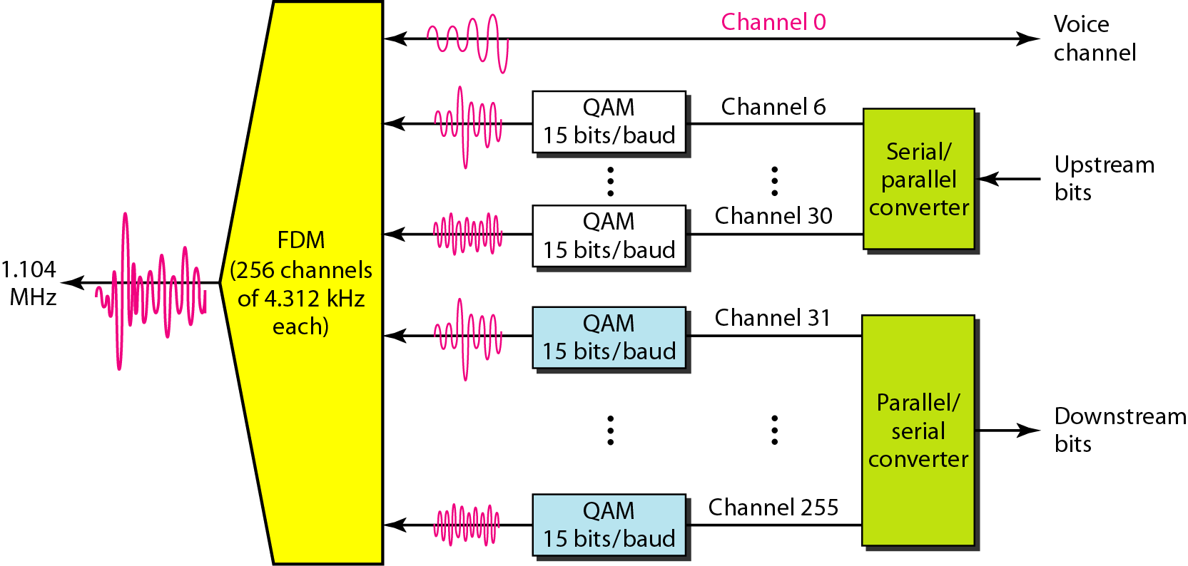
Figure 9.10 Discrete multitone technique

Slide 30
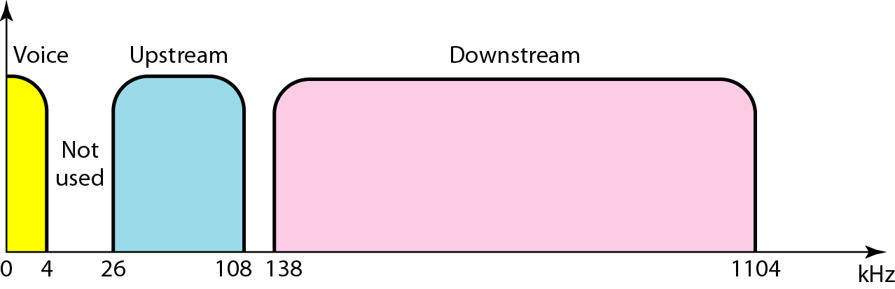
Figure 9.11 Bandwidth division in ADSL

Slide 31
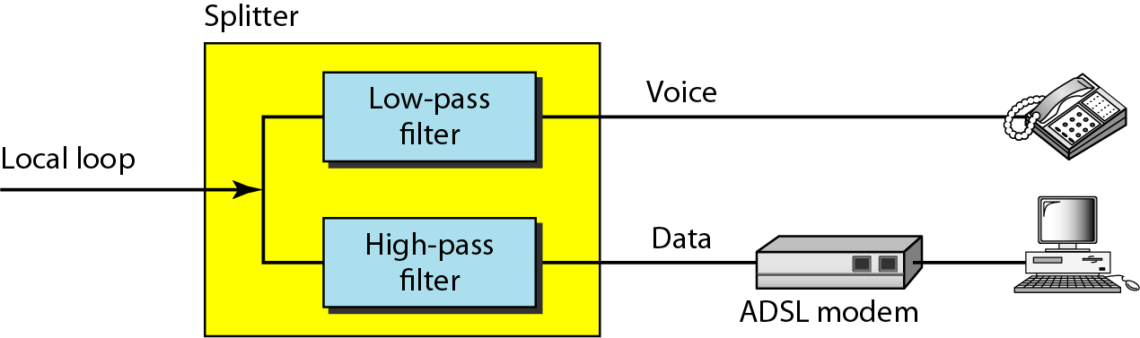
Figure 9.12 ADSL modem

Slide 32
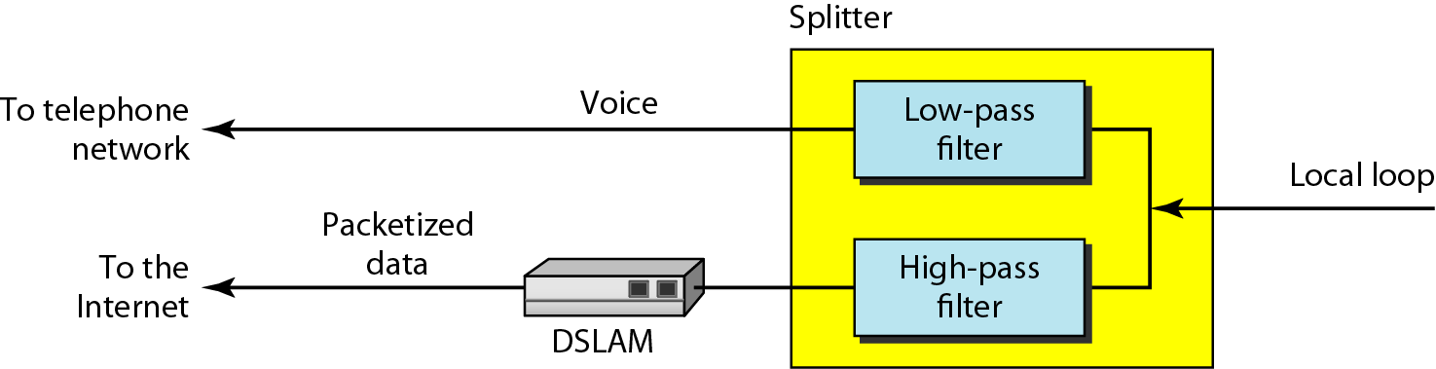
Figure 9.13 DSLAM

Slide 33
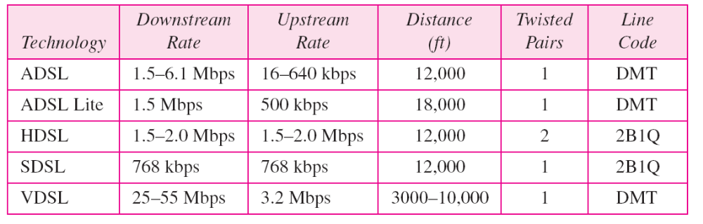
Table 9.2 Summary of DSL technologies

Slide 34
9-4 CABLE TV NETWORKS
The cable TV network started as a video service provider, but it has moved to the business of Internet access. In this section, we discuss cable TV networks per se; in Section 9.5 we discuss how this network can be used to provide high-speed access to the Internet.
Topics discussed in this section:
Traditional Cable Networks
Hybrid Fiber-Coaxial (HFC) Network

Slide 35
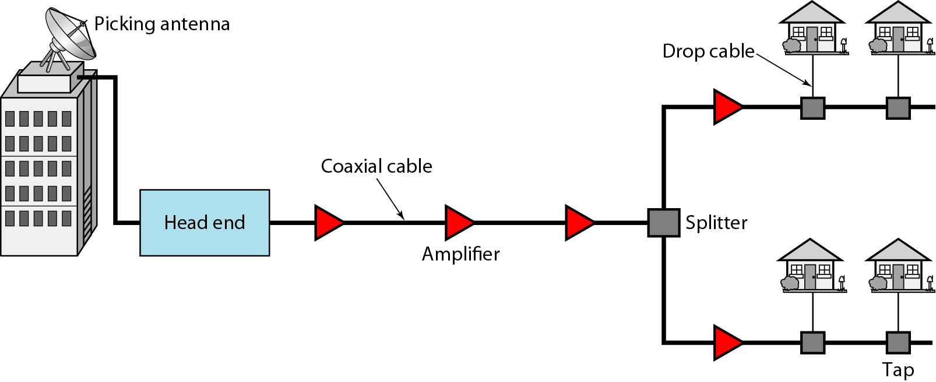
Figure 9.14 Traditional cable TV network

Slide 36
Note
Communication in the traditional cable TV network is unidirectional.

Slide 37
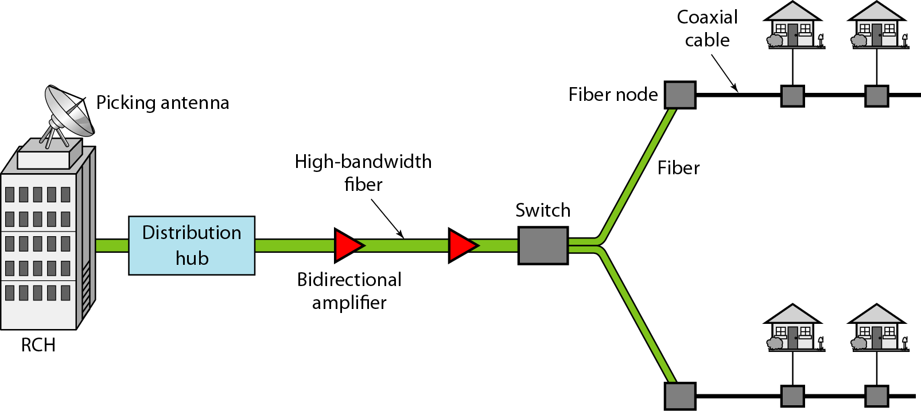
Figure 9.15 Hybrid fiber-coaxial (HFC) network

Slide 38
Note
Communication in an HFC cable TV network can be bidirectional.

Slide 39
9-5 CABLE TV FOR DATA TRANSFER
Cable companies are now competing with telephone companies for the residential customer who wants high-speed data transfer. In this section, we briefly discuss this technology.
Topics discussed in this section:
Bandwidth
Sharing
CM and CMTS
Data Transmission Schemes: DOCSIS

Slide 40
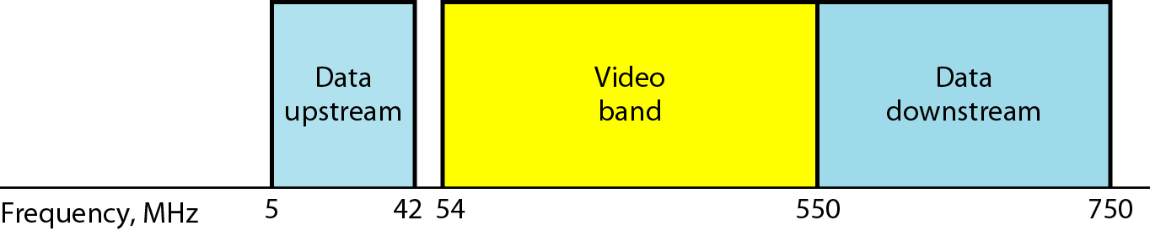
Figure 9.16 Division of coaxial cable band by CATV

Slide 41
Cable Modems
Traditional modems are restricted to 4 KHz by the narrow bandwidths of local loops.
Coaxial cable on the other hand has a much higher available bandwidth of 750 MHz.
This bandwidth is divided up into 6 MHz bands using FDM (Frequency Division Multiplexing). Each 6 MHz band carries TV channel signals.
Two channels are set aside for use by the cable modem to send and receive user information.
Downloading uses a 6 MHz bandwidth above 40 MHz, and 64-QAM (6 bits/baud) to achieve a 36 Mbps download rate.
Currently technology sets this rate to between 3 and 10 Mbps.
Uploading uses a 6 MHz bandwidth below 40 MHz, and QPSK (2 bits/baud) to achieve a 16 Mbps download rate.
The limitation is due mainly to the noisier environment in residential areas.
Current technology sets this to between 500 Kbps and 1 Mbps.

Slide 42
Note
Downstream data are modulated using the 64-QAM modulation technique.

Slide 43
Note
The theoretical downstream data rate
is 30 Mbps.

Slide 44
Note
Upstream data are modulated using the QPSK modulation technique.

Slide 45
Note
The theoretical upstream data rate
is 12 Mbps.

Slide 46
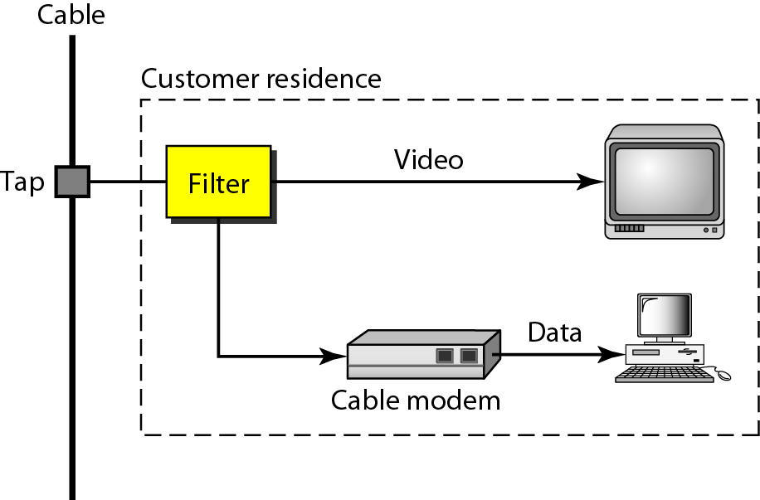
Figure 9.17 Cable modem (CM)

Slide 47
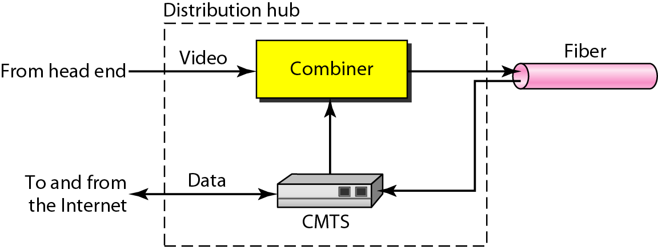
Figure 9.18 Cable modem transmission system (CMTS)

